Slide 1

Science Logic
SL1 Dist
API - DB
Raul Diez Canseco Christian Galarza

Slide 2
Overview
Distributed System
Upgrade 8.12 – 8.14
Review MariaDB
API - Get/Post/Delete
DataBase

Slide 3
overview
Help us with monitoring different kind of devices
Bring us information about their functionality in real-time
All over in a web site

Slide 4
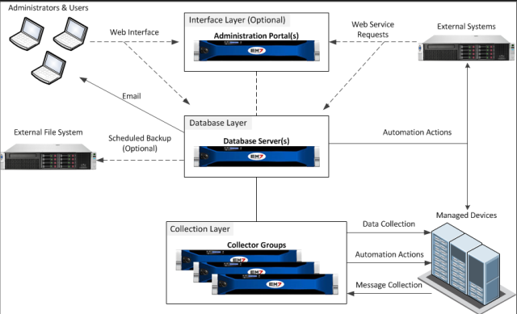
Distributed System
Distributed
Distributed

Slide 5
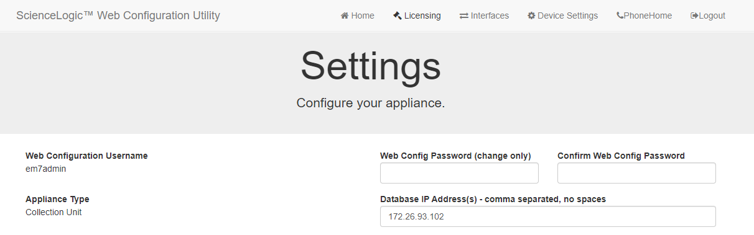
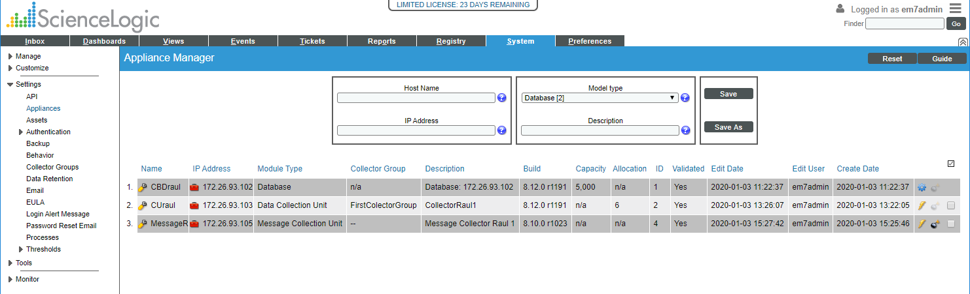
Configuration
Configure Distributed system
https://ip-address-of-appliance:7700
In SL1

Slide 6
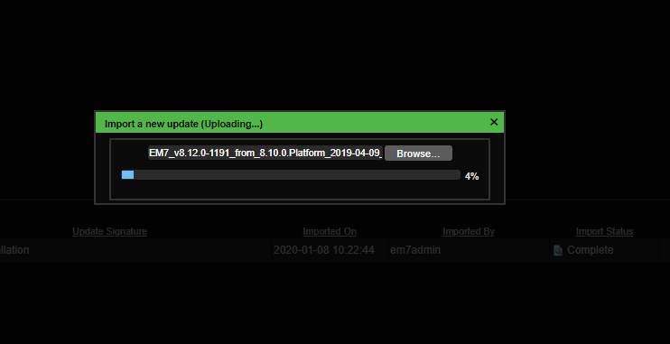
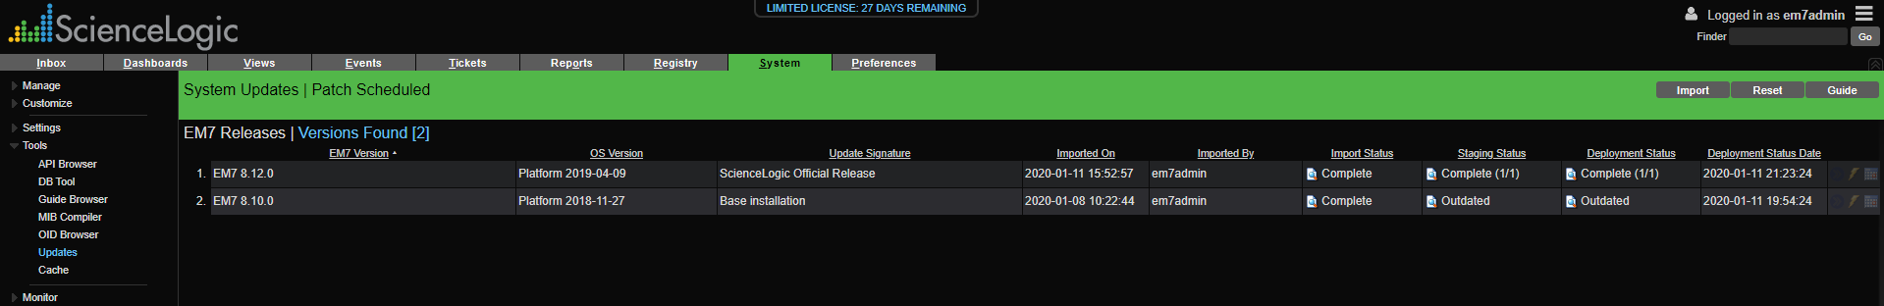
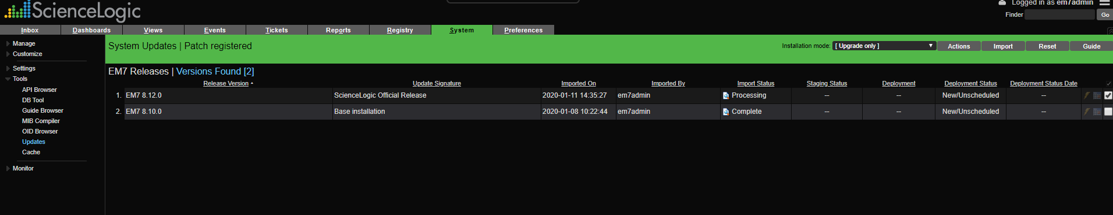
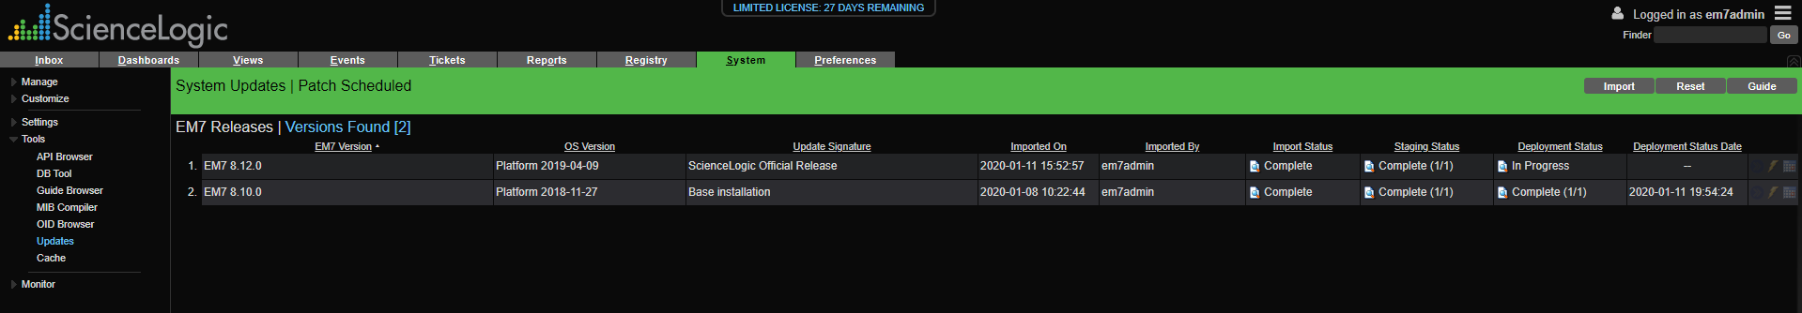
Upgrade

Slide 7
Review MariaDB

Slide 8
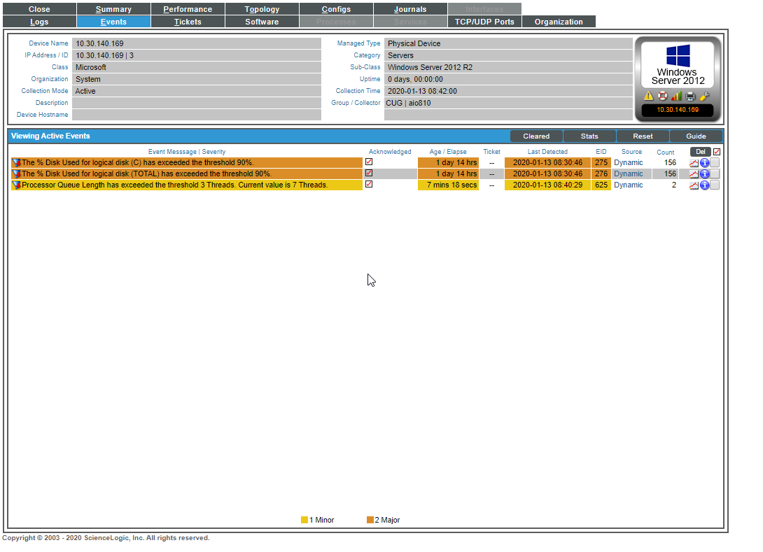
Events

Slide 9
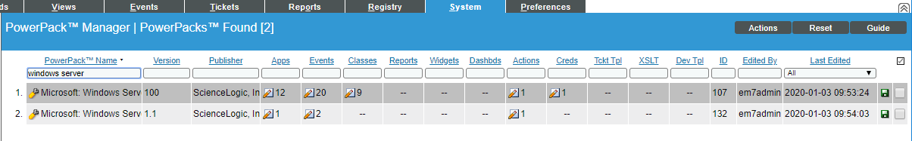
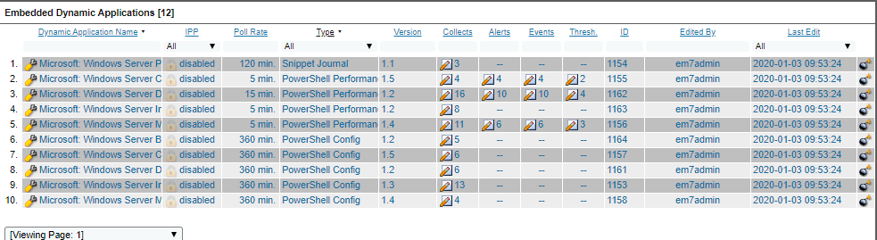
Windows Server Power Pack
Windows Server PowerPack

Slide 10
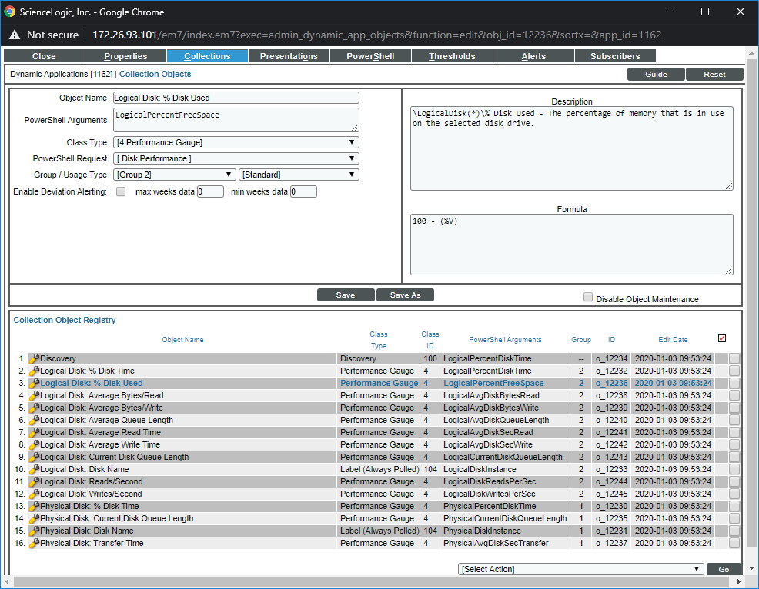
Collection objects

Slide 11
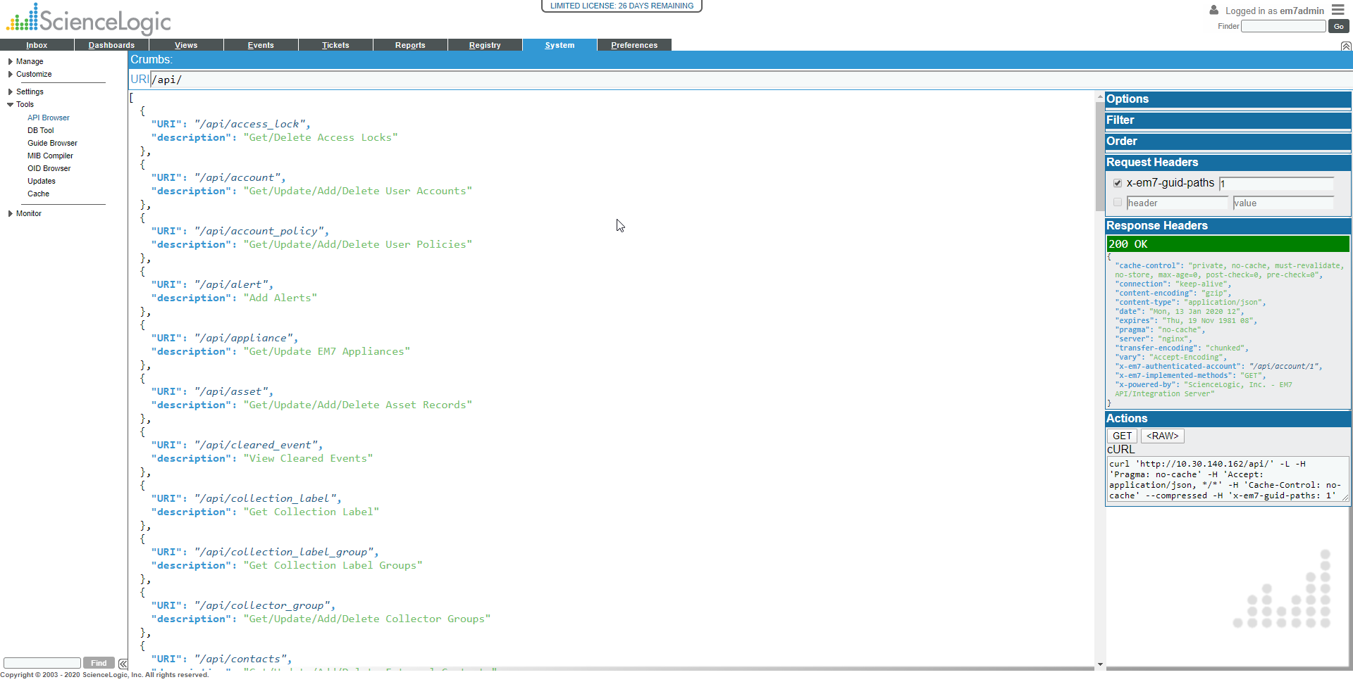
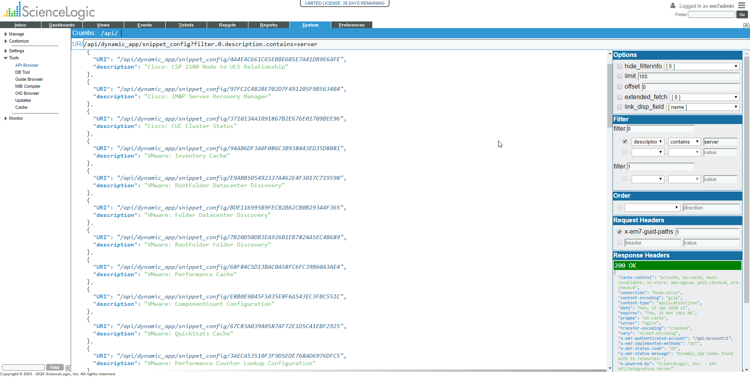
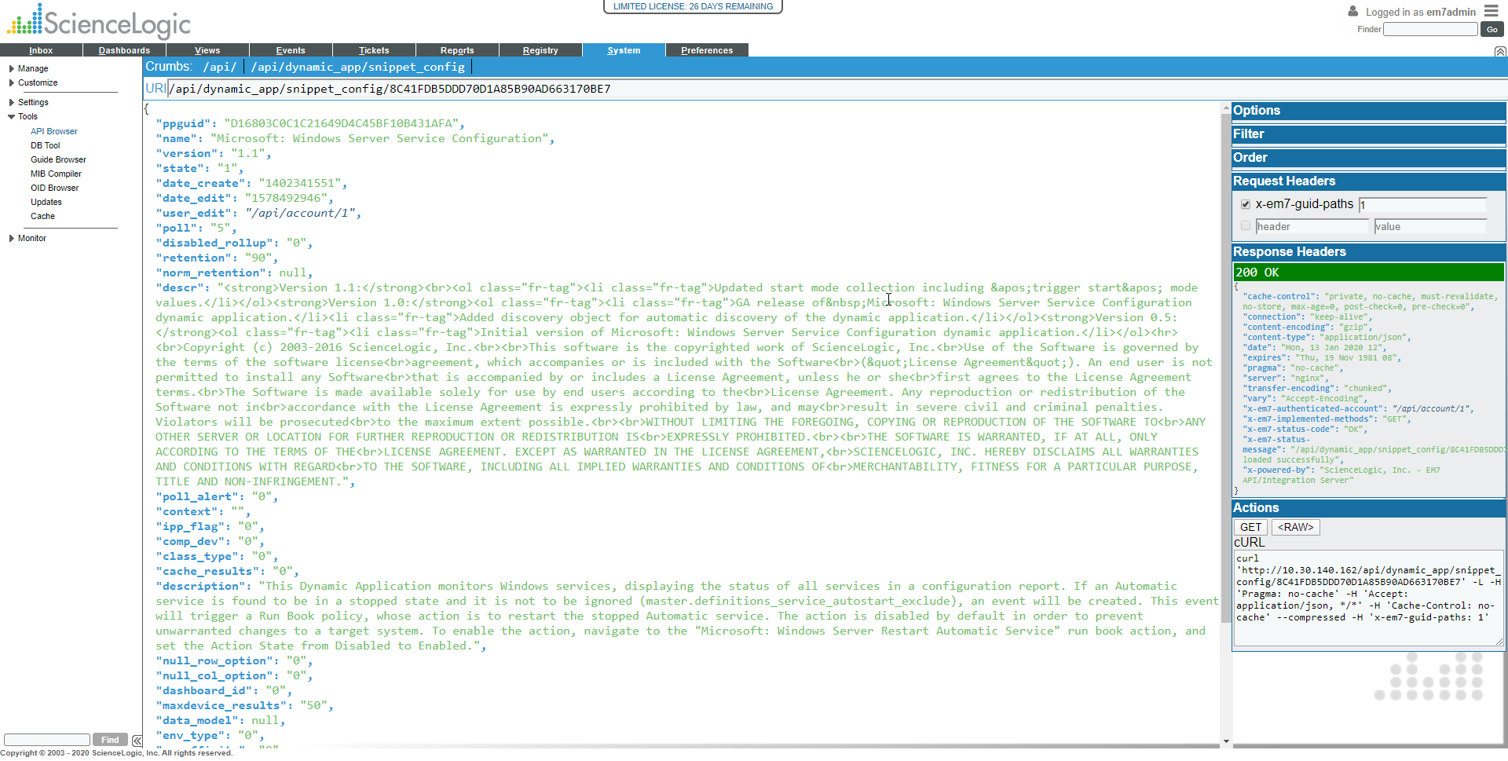
API - Get/Post/Delete

Slide 12
DataBase

